Slide 1




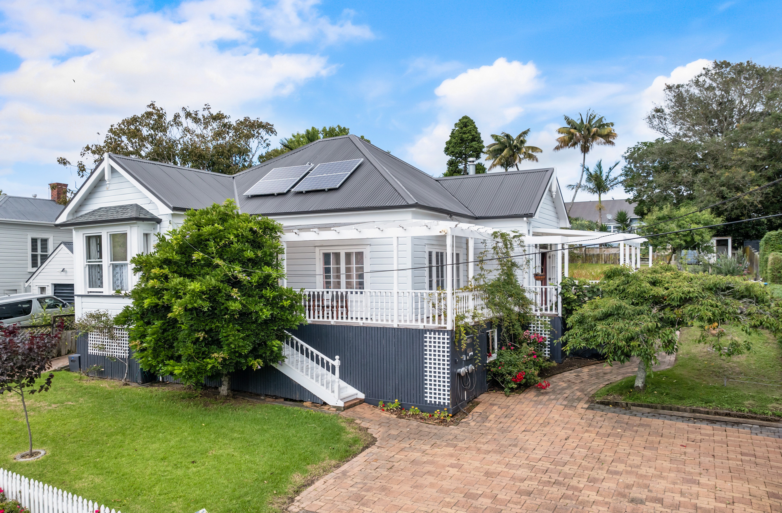

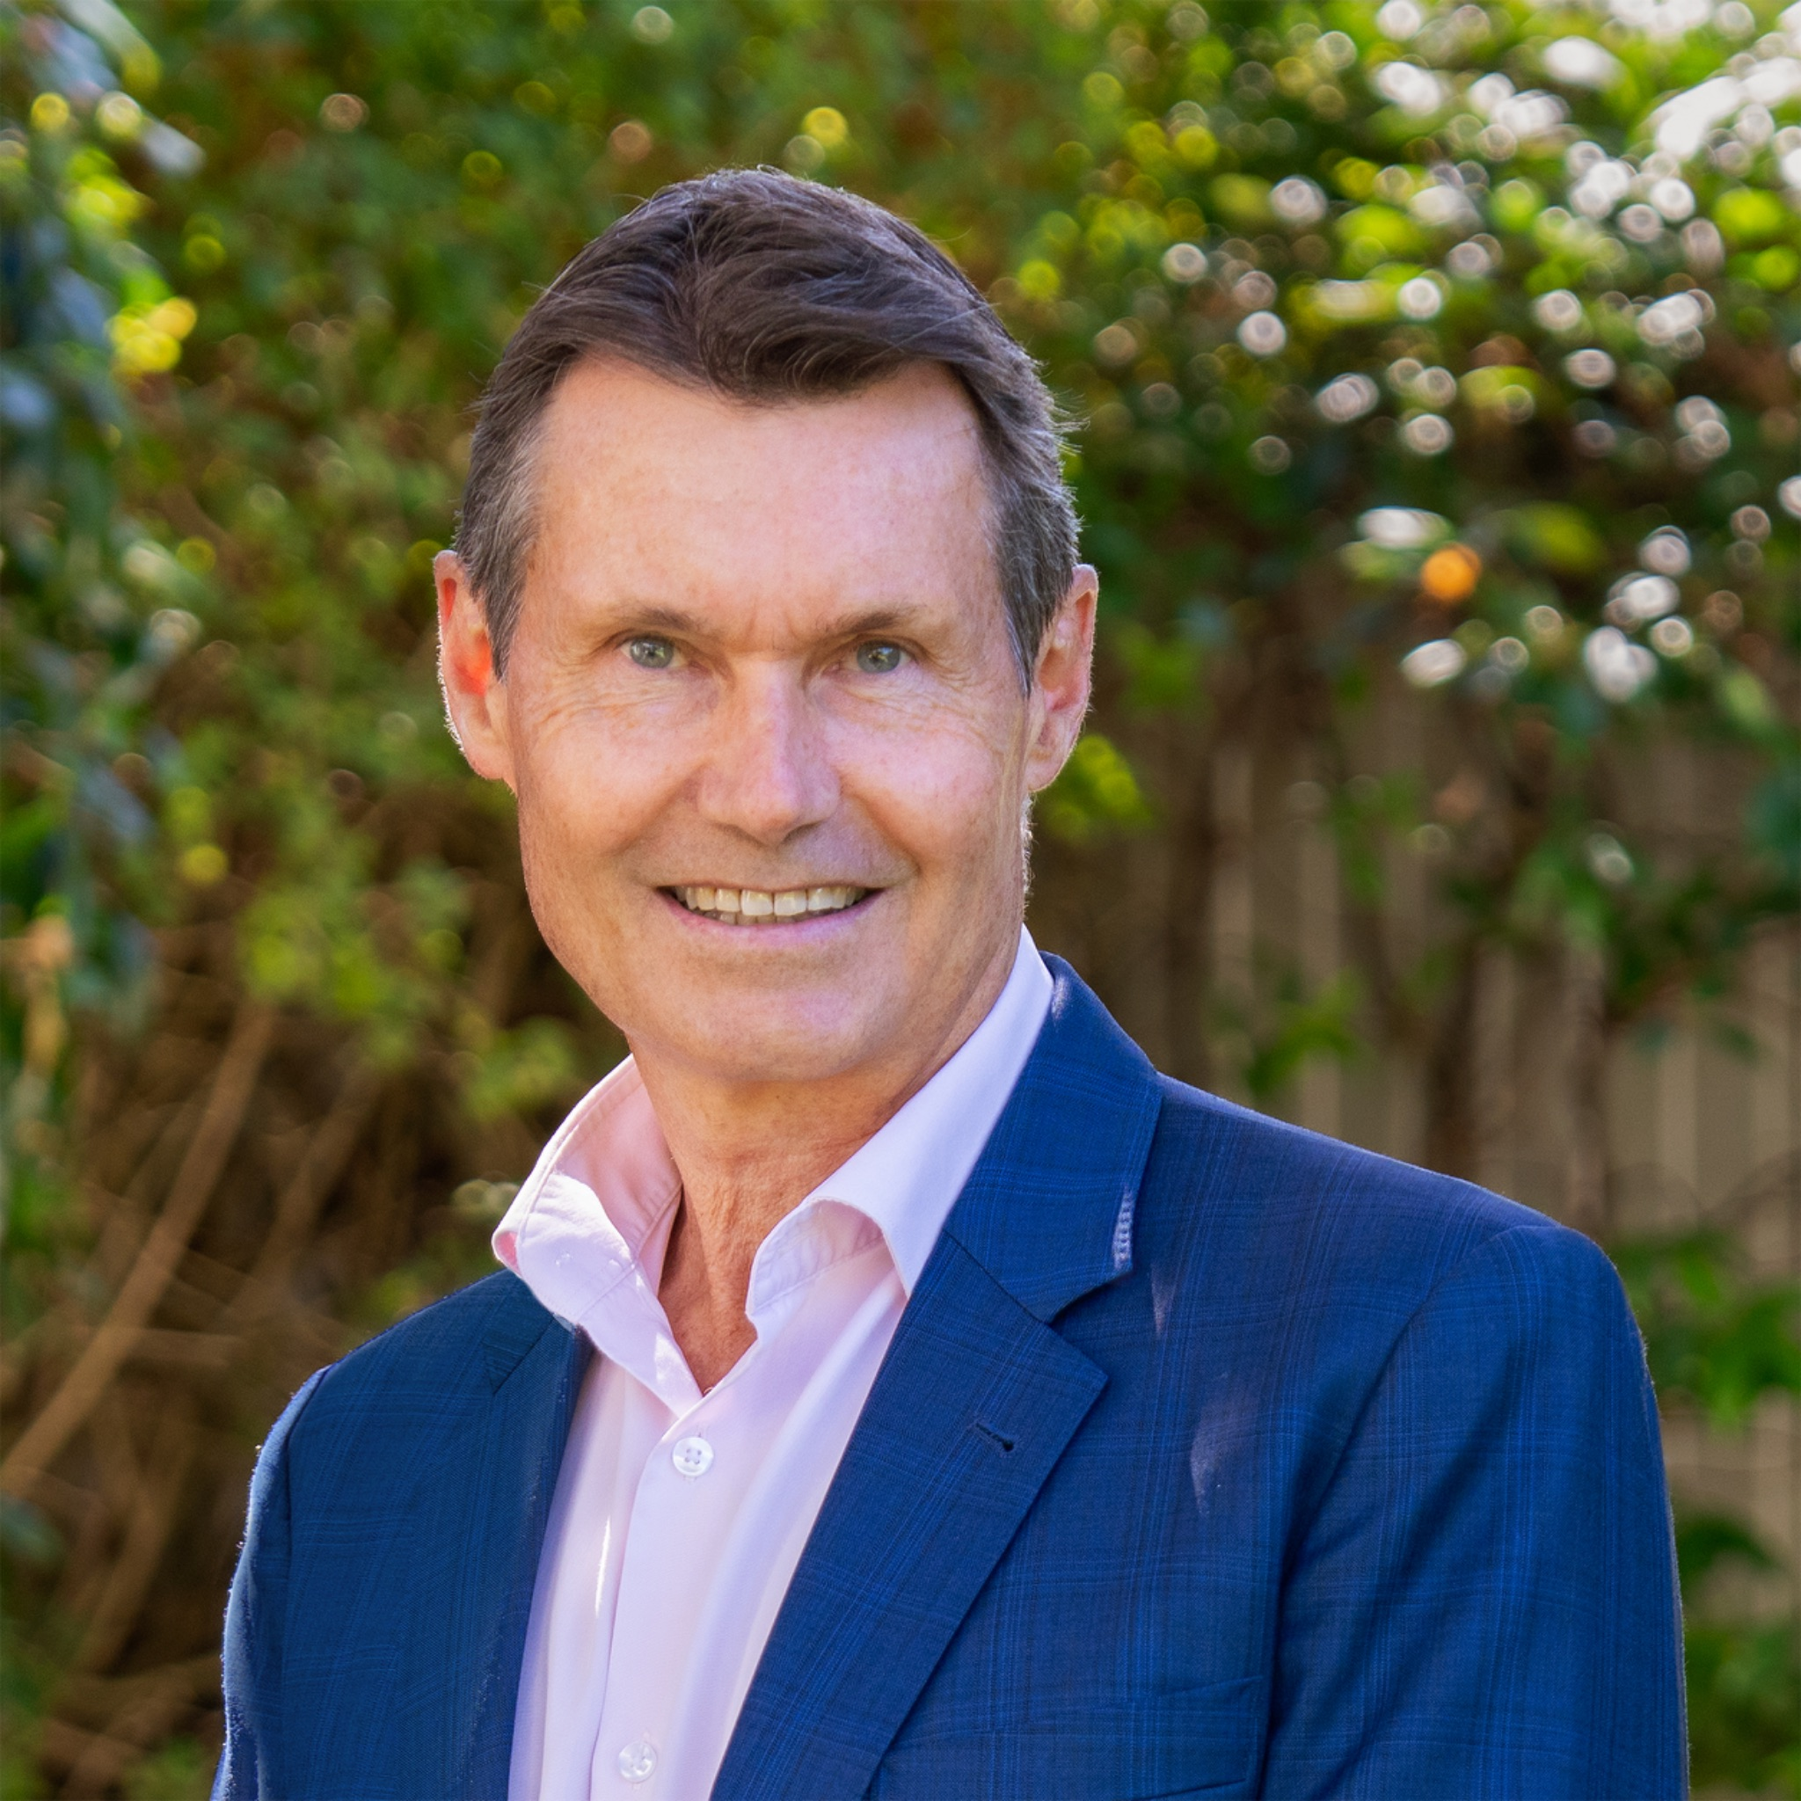
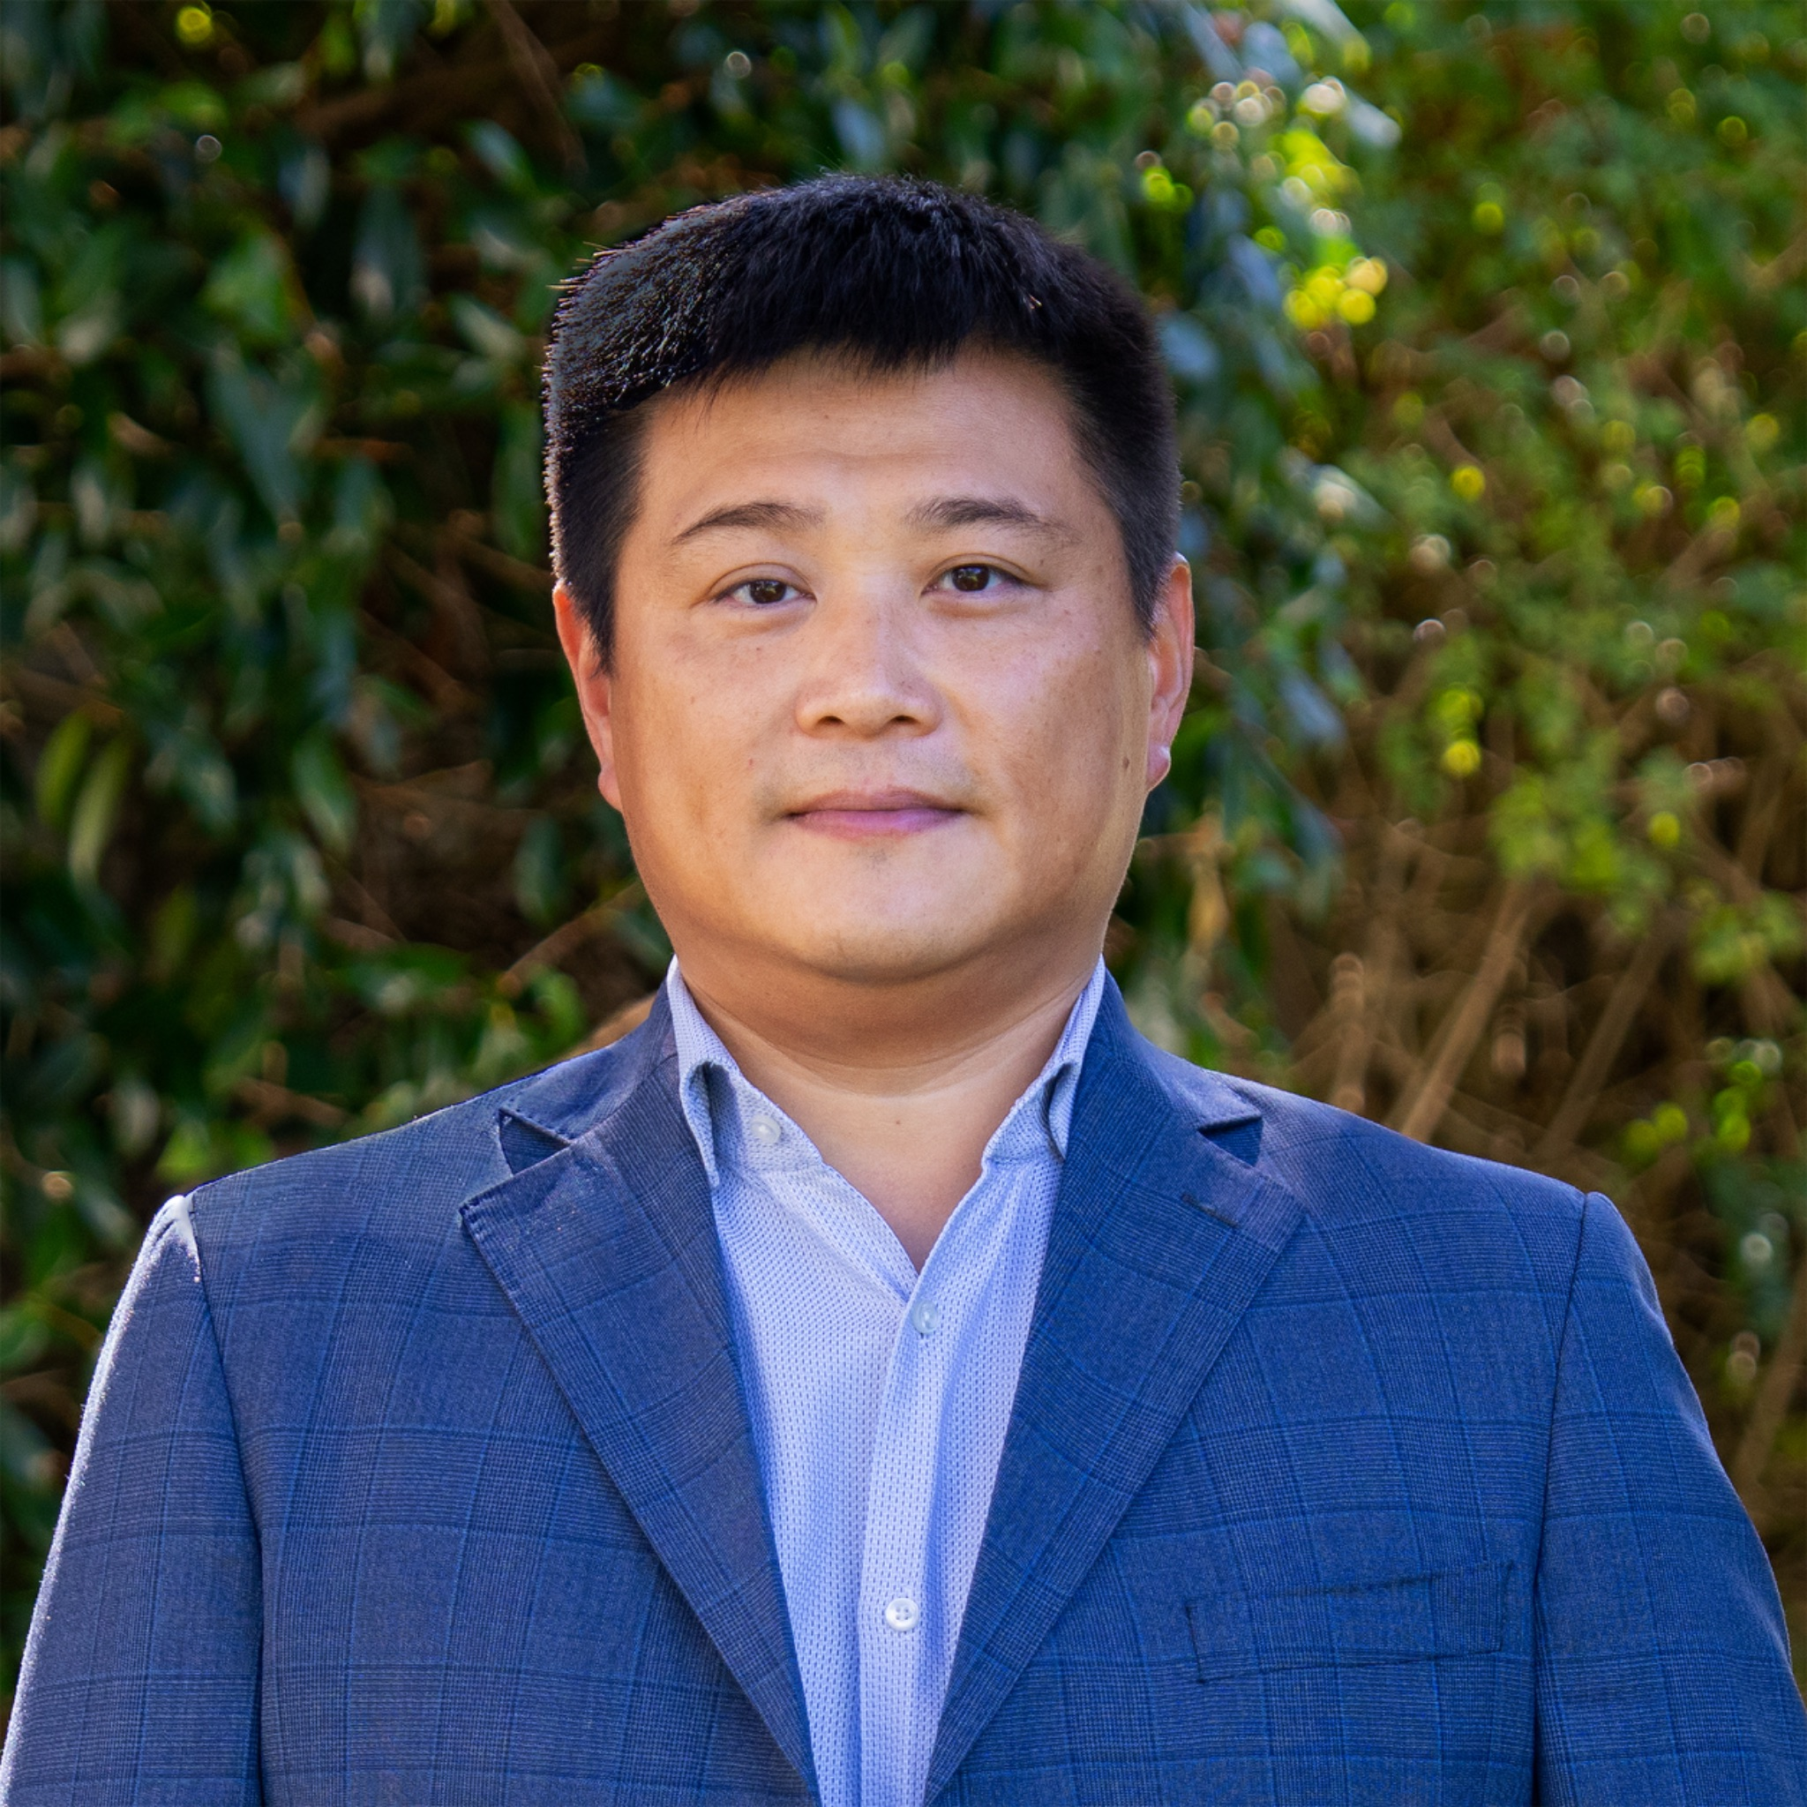

CASE STUDY
122 Grange Road,
Mount Eden
4+2
1+ 1
1+ 1
3
911m2
Sale Strategy: Auction
Price: $2,750,000
Council Valuation $3,300,000
Sold Date: 11.3.26
Days on Market: 21
Total Campaign Viewings: 34
Registered Bidders: 2
Active Bidders: 2
Polish the Gem – Mt Eden Opportunity
This property was a unique opportunity for purchasers with vision and keen to enhance and add value to this character home on generous 911m2 grounds in a sought-after location.
Attracting interest from developers and buyers keen on renovating a heritage home, the property was sold under the hammer at auction on 11 March 2026.
www.mikerobson.co.nz
Mike Robson
Licensee Agent
Ph 021 484 288
mike.robson@raywhite.com
James Wang
Licensee Salesperson
Ph 021 658 357
james.w@raywhite.com

