Slide 1
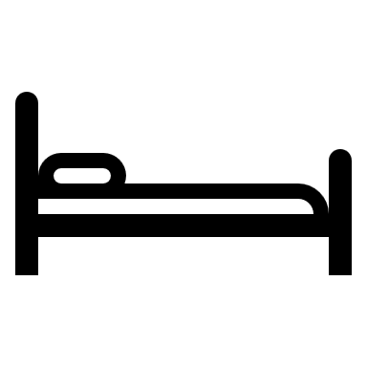
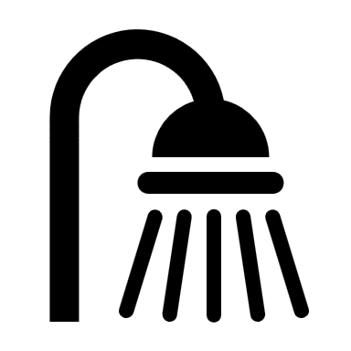


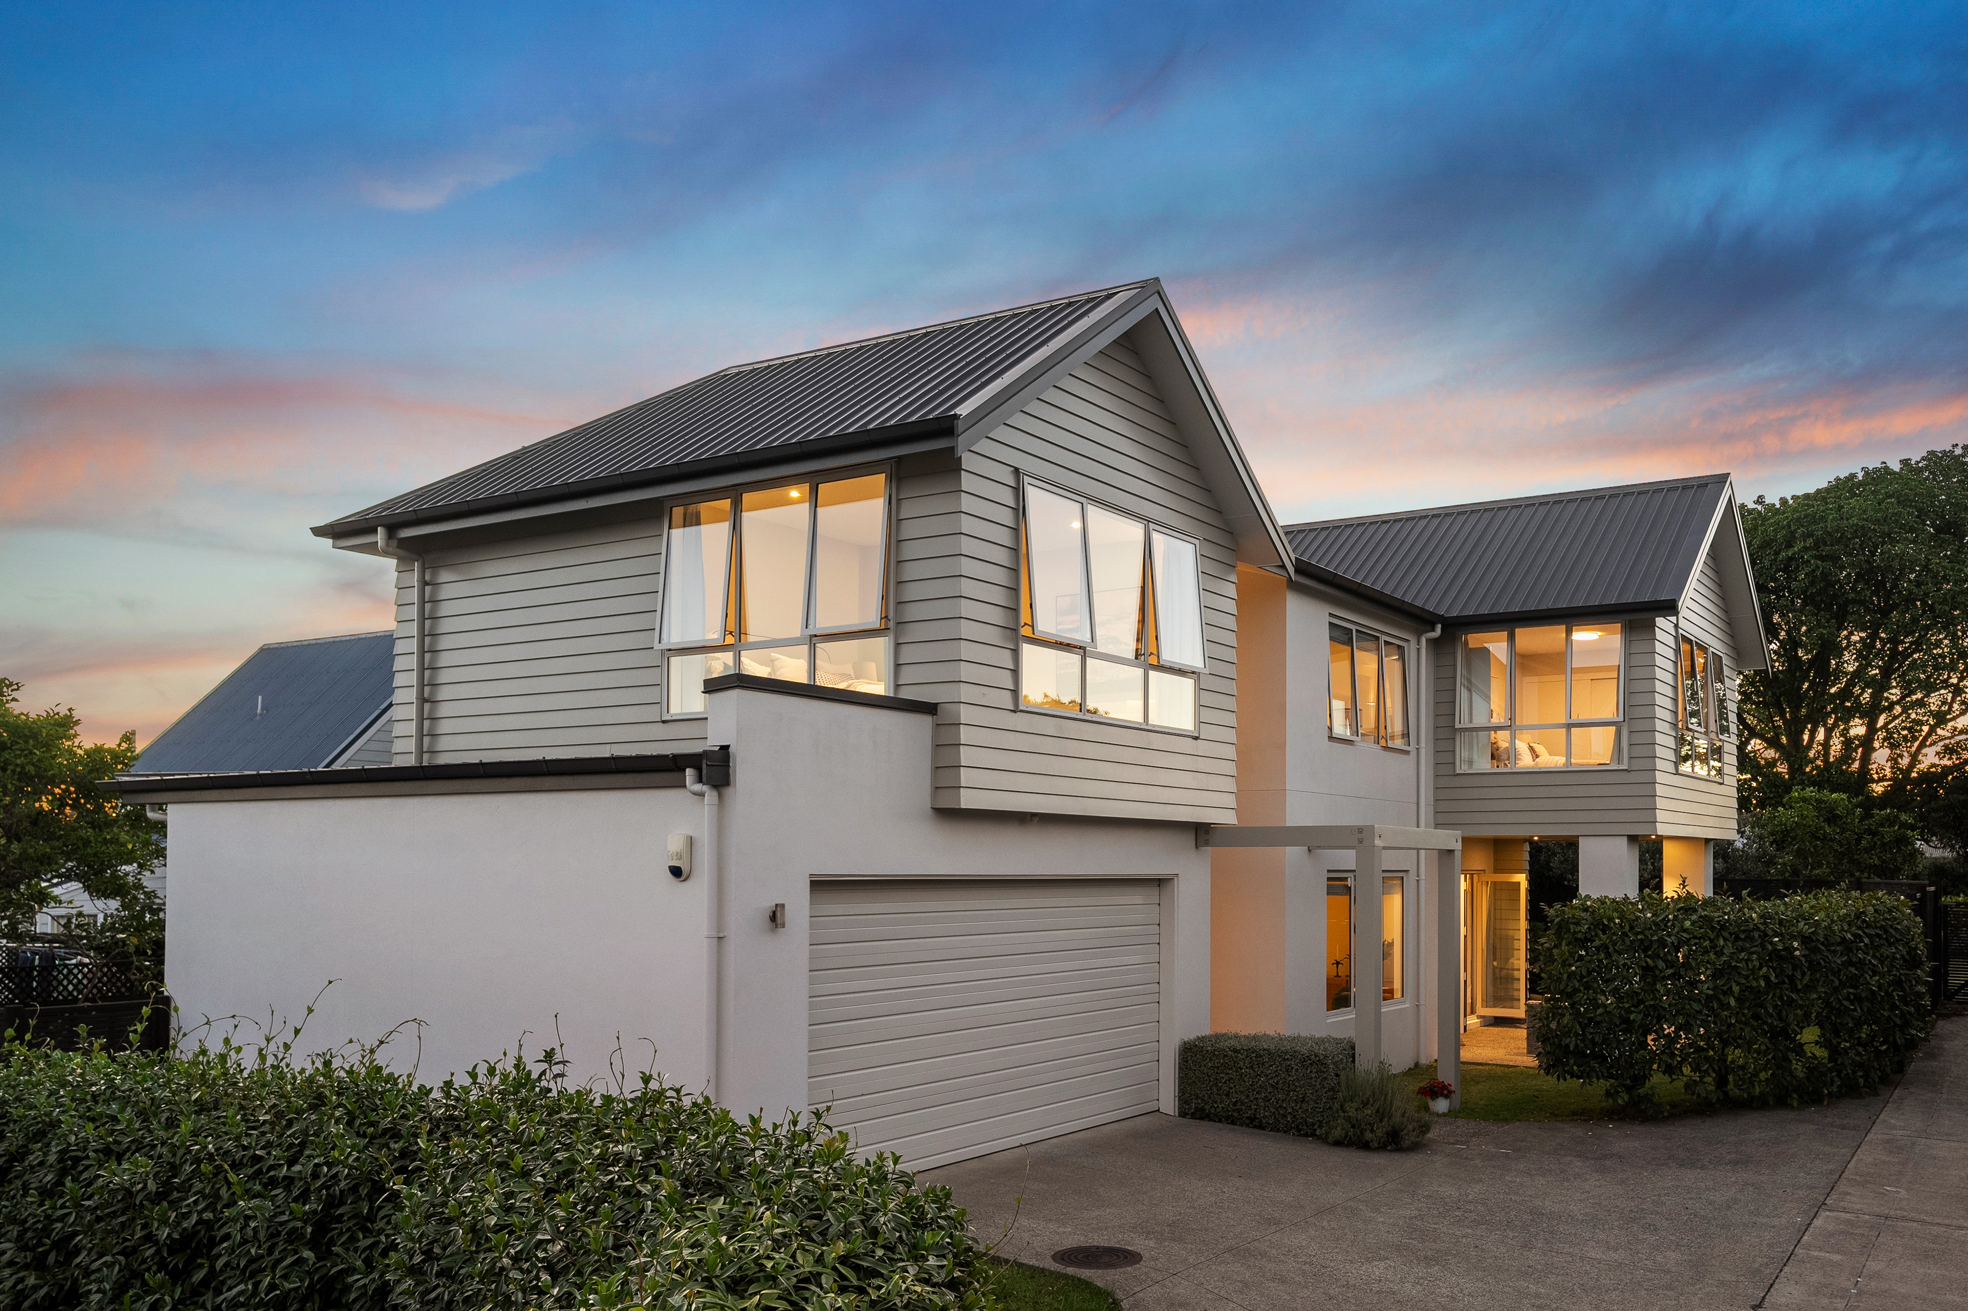

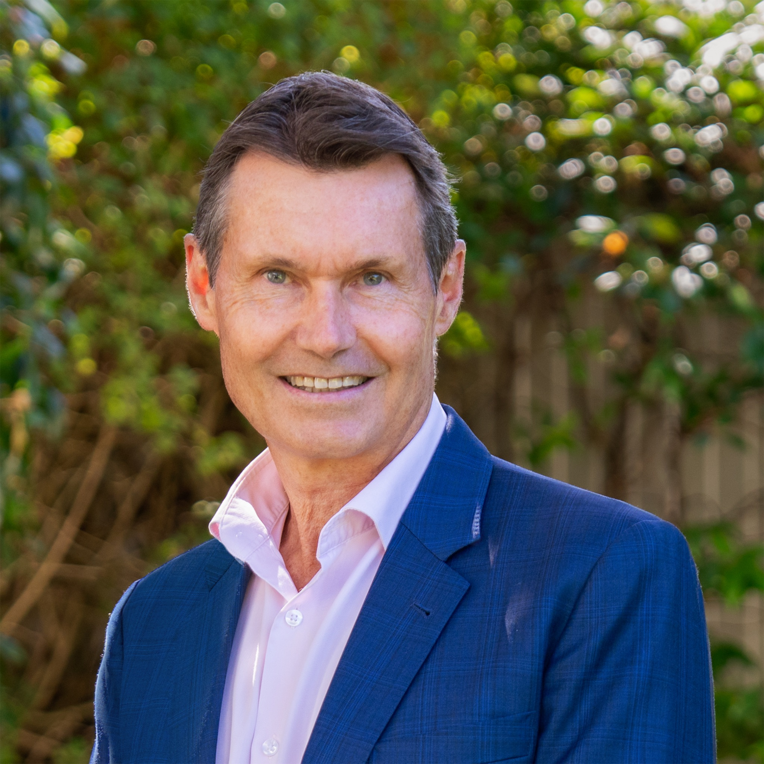
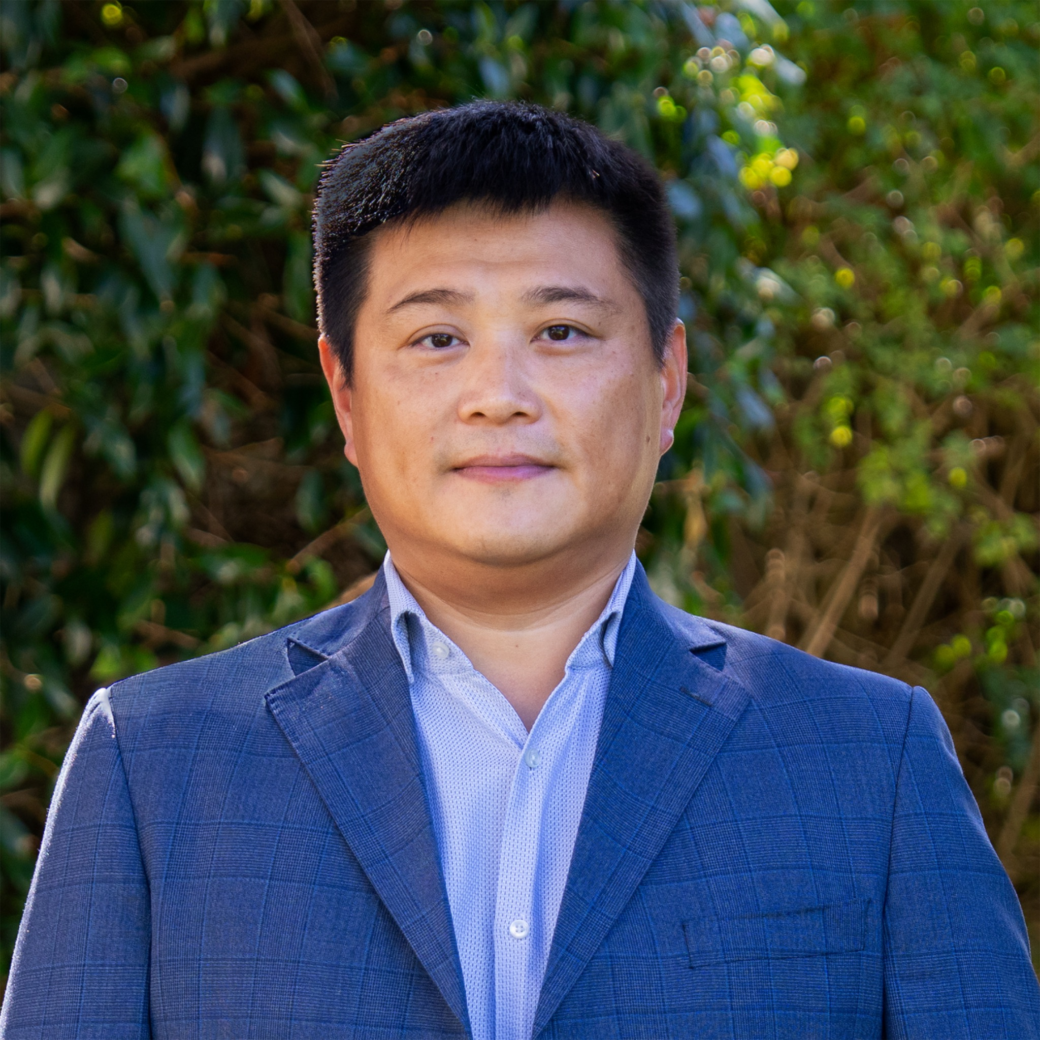
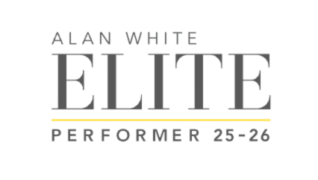
CASE STUDY
9A Horoeka Avenue,
Mount Eden
4
2.5
3
2
441m2
Sale Strategy: Auction
Price: $2,560,000
Council Valuation $2,450,000
Sold Date: 25.2.26
Days on Market: 21
Total Campaign Viewings: 44
Registered Bidders: 2
Active Bidders: 2
Contemporary Comfort in Triple Grammar Zone
Beautifully designed for effortless modern living, this impressive Mt Eden residence delivers space, style, and a practical layout to suit every stage of family life.
On the market for a three-week auction campaign, the property sold under the hammer for $2,560,000, 4.5% above the Council Valuation.
www.mikerobson.co.nz
Mike Robson
Licensee Agent
Ph 021 484 288
mike.robson@raywhite.com
James Wang
Licensee Salesperson
Ph 021 658 357
james.w@raywhite.com

